Slide 1
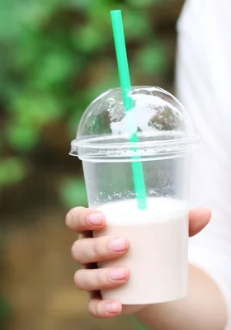
OMAO Biodegradable Plastic Cups
ARIANNA HAVEN, RISHI JARMARWALA, ISHA NEGI, ZACHARY STECHER
December 14, 2021

Slide 2
Overview
Introduction to OMAO and the product
Survey Summary
Main Findings

Slide 3

Who is
?
NY-based Company focused on creating eco-friendly, 100% biodegradable alternatives to single use plastic products made out of Polyhydroxyalkanoate (PHA) Plastic.
Notes:
Currently makes 100% biodegradable, compostable, eco-friendly straws
Polyhydroxyalkanoate (PHA)
Biodegrades in 90 Days
Don’t have to worry about how you dispose of the product because it will decompose anywhere
Not paper based (so doesn’t get soggy!)
Wants to get into the cup business

Slide 4
Product Attributes
Opacity
Logo
Material
Whether or not the cup is see-through
OMAO’s logo printed on the cup or not
What the cup is made of
Volume
Price
Quantity
How much fluid the cup holds
Cost per cup and per package
Number of cups in a package

Slide 5
Attribute Levels
Opacity
Logo
Material
Opaque or Translucent
Logo or No Logo
Sustainable Plastic or Regular Plastic
Volume
Price
Quantity
9 oz or 16 oz
$0.05, $0.10, $0.15, $0.20, $0.25, $0.30
25, 50, 75, 100

Slide 6
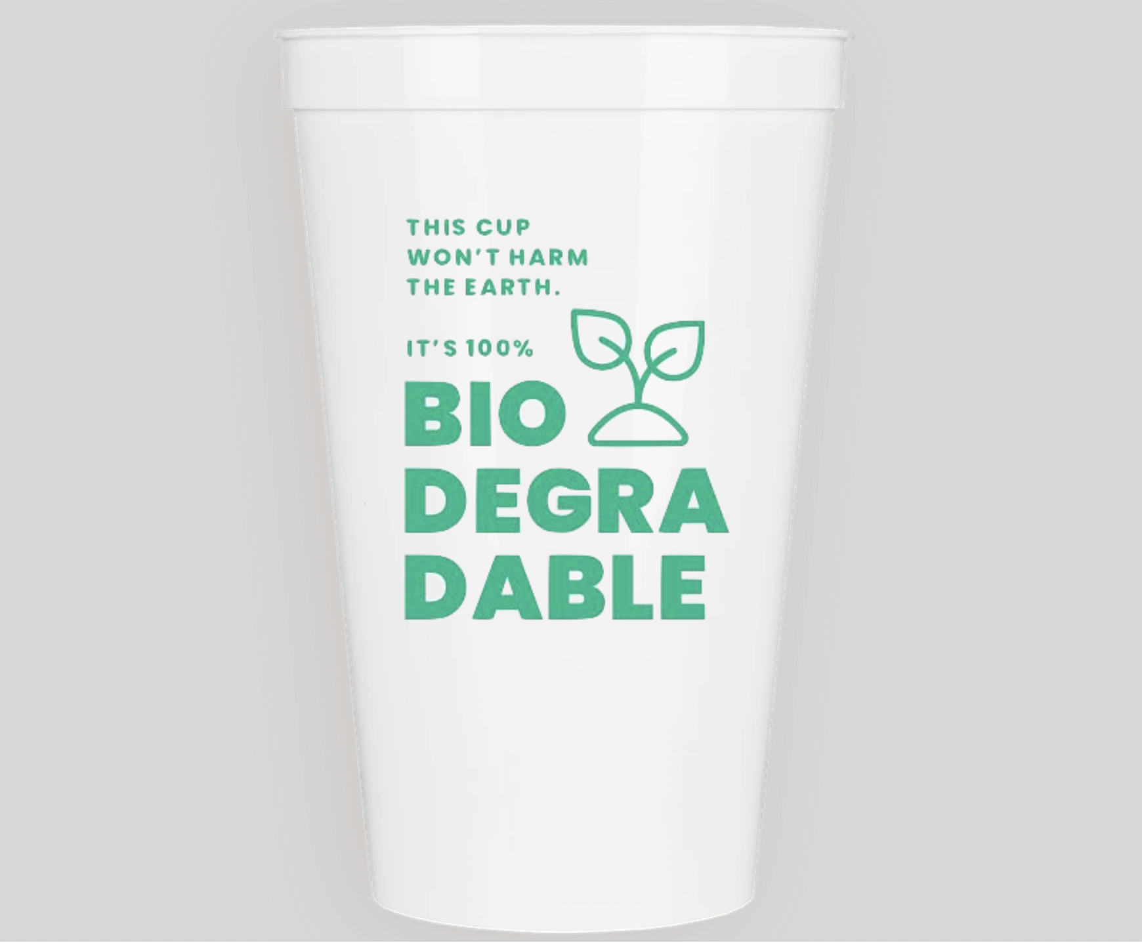
OMAO’s Ideal Cup
Material | Sustainable Plastic
Appearance | Opaque w/ Logo
Price/cup | (TBD)
Quantity | 50 Cups
Price/package | (TBD)
Volume | 12 or 16 OZ

Slide 7
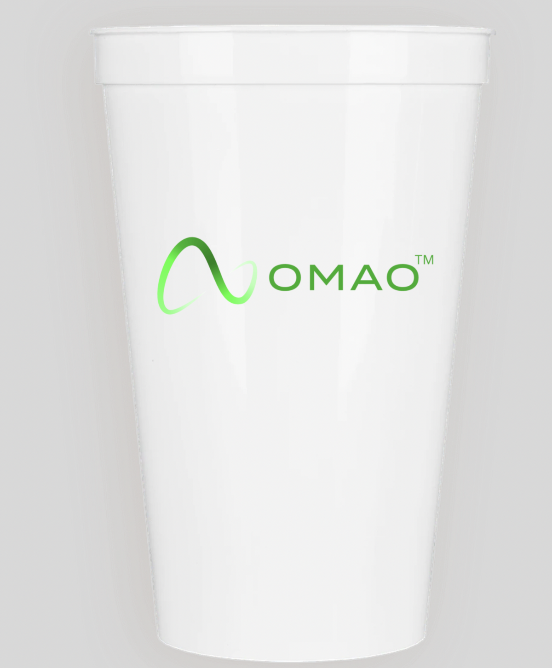
Logo Changed to Ease Confusion

Slide 8
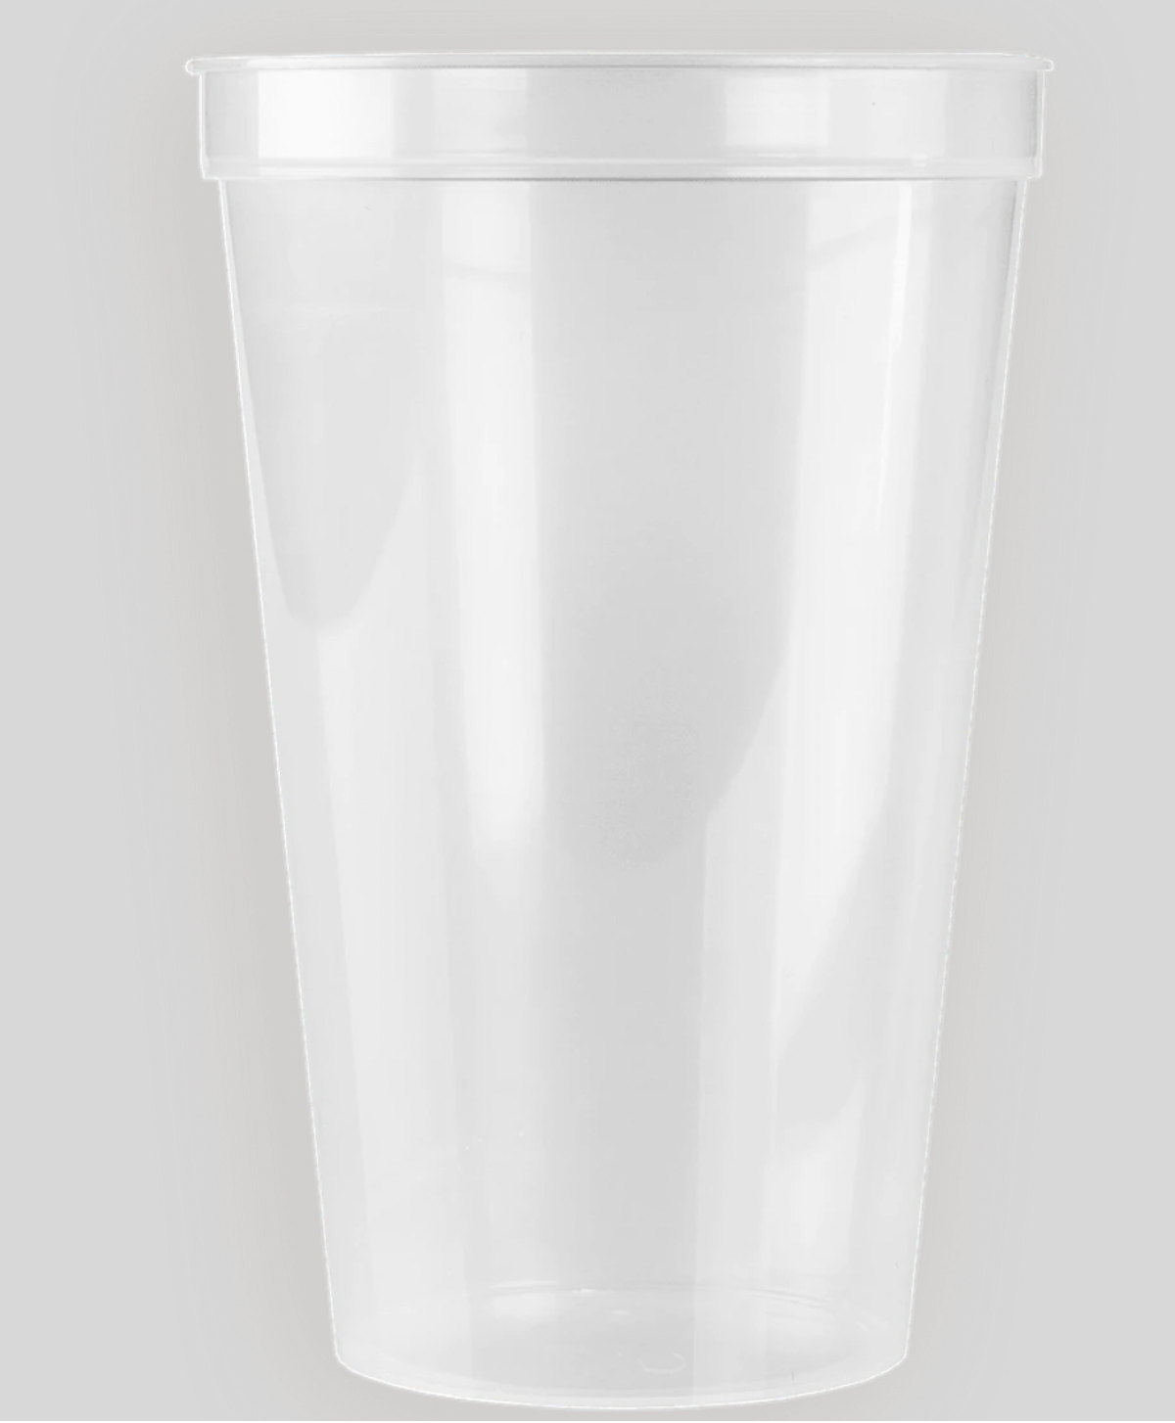
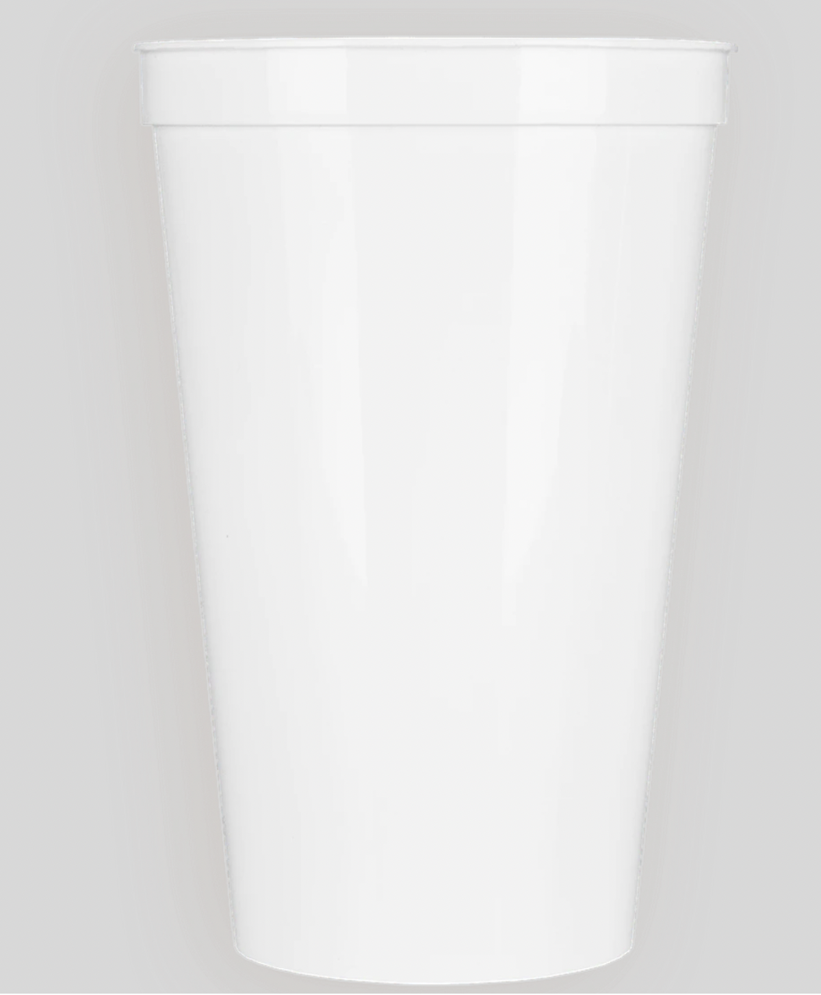
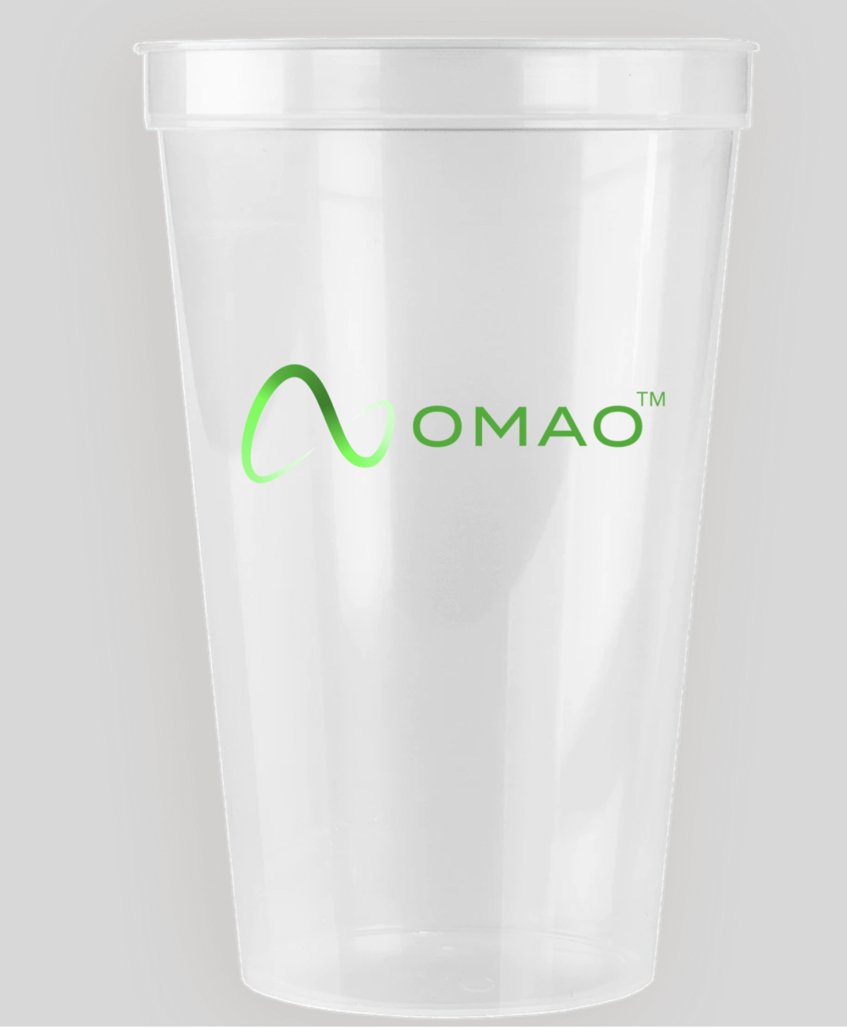
Cup Options

Slide 9
Overview
Introduction to OMAO and the product
Survey Summary
Main findings

Slide 10
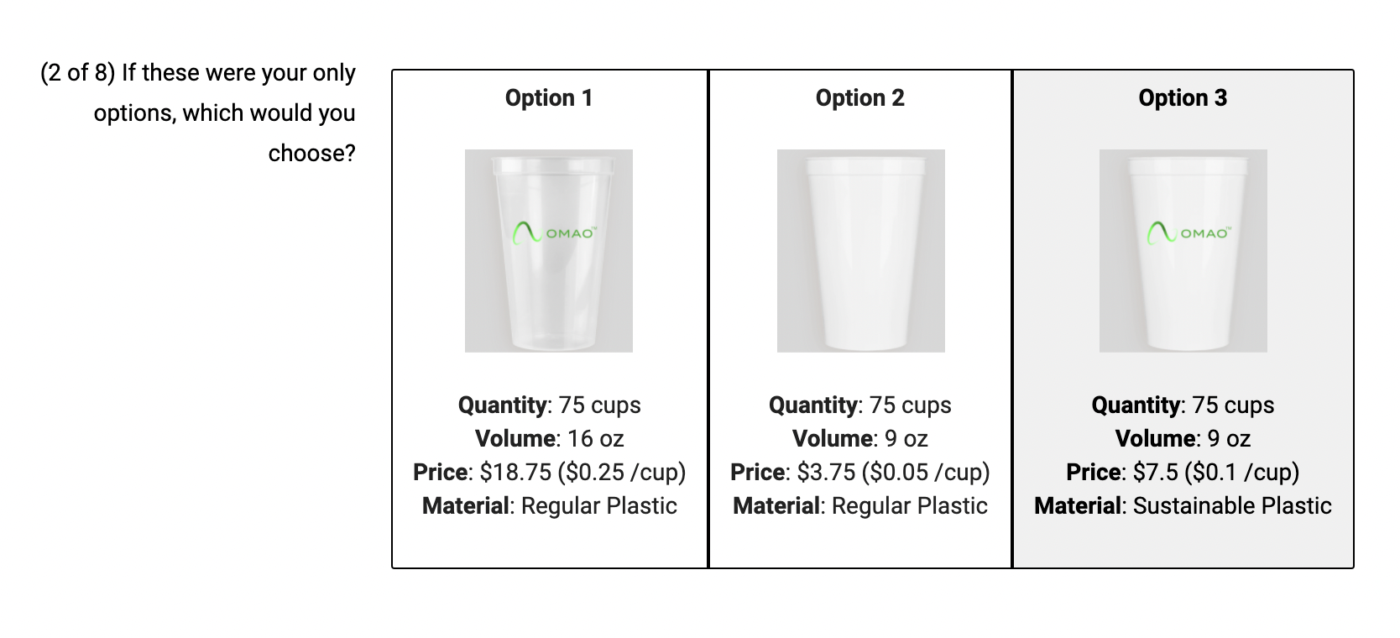
Example Choice Question
Each respondent got 8 questions with 3 choices.

Slide 11
Sample Size
361
181
Total Responses
Used Responses

Slide 12
Gender Summary
51%
45%
04%
Of the 181 respondents...
Women
Men
Neutral
Notes:
“Other” includes gender non-conforming and prefer not to say

Slide 13
Employment Status
50%
21%
15%
14%
Of the 181 respondents...
employed
students
unemployed
other

Slide 14
Age Summary
38%
62%
Of the 181 respondents...
25 and Under
Over 25

Slide 15
Overview
Introduction to OMAO and the product
Survey Summary
Main Findings

Slide 16
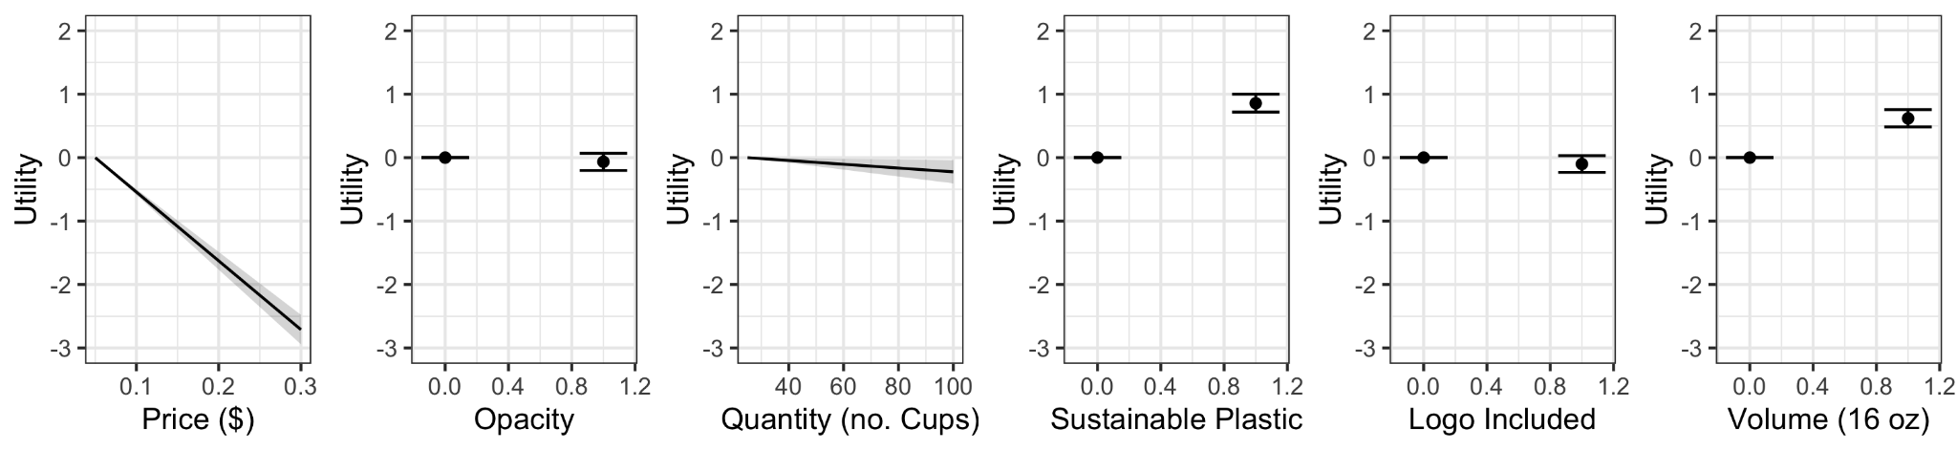
Utility Coefficients & Uncertainties
Simple Logit Model
Notes:
2 continuous terms
4 discrete terms
Negative impacts
- increase in price,
- increase in quantity (low impact),
- opaque, logo
Positive
- sustainability - high increase in utility if sustainable

Slide 17
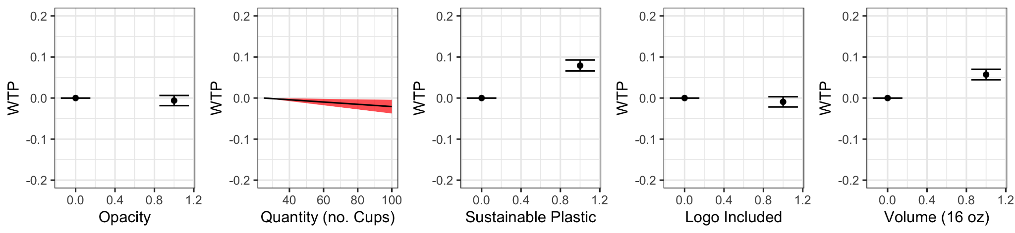
WTP Simple Logit Model
Cup material and volume have largest effects on consumer choice.
Notes:
We created a Willingness to Pay Model to analyze which attributes had they greatest effects on consumer choice. Indicators in continuously varying attributes are steep slopes while indicators in discrete attributes are large displacements between baseline levels and secondary levels. Therefore, we see that quantity, opacity, and logo have little influence on consumer choice while sustainability of the plastic and volume of the cup do.

Slide 18
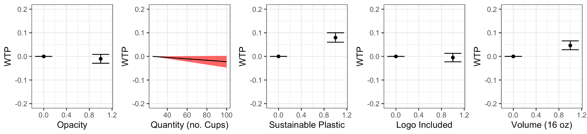
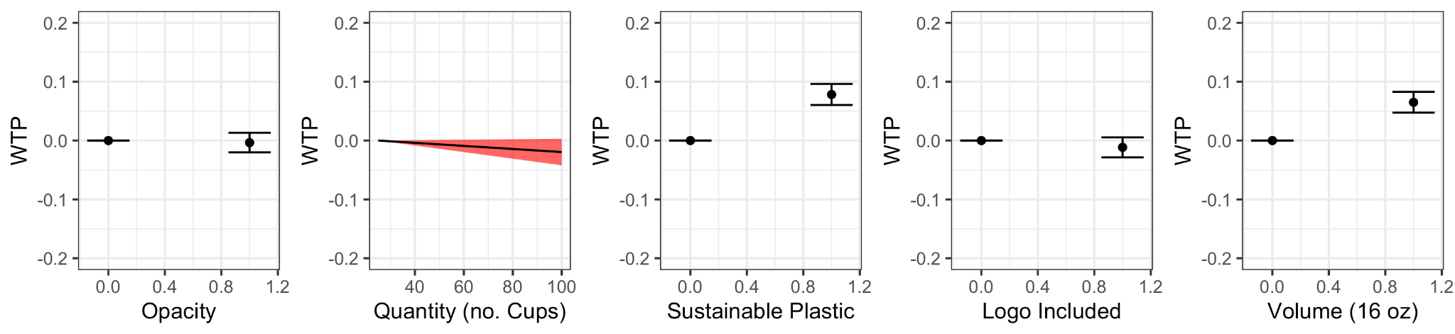
WTP Subgroup Models: By Age
25 & Under
Above 25
Notes:
While these two groups share general preferences, younger people are less preferential to a larger cup, transparent cup, and the cup not having a logo.

Slide 19
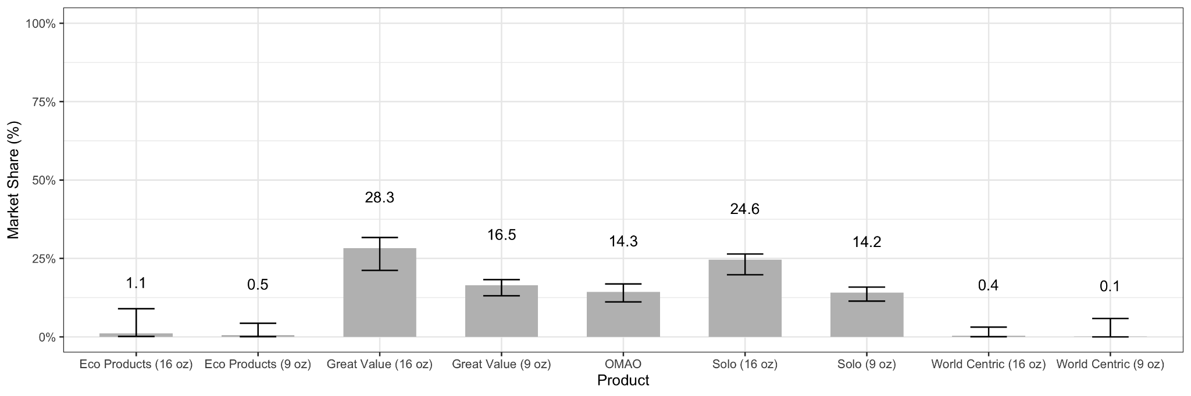
Baseline Product
Market Share
$0.20/cup, Opaque, Logo, 16 oz, Sustainable, Pack of 50
Notes:
Competitors:
Eco Products
World Centric
Solo
Great Value
16 oz or 9 oz for each
4 sustainable 4 regular
Started market share on a baseline design
$0.20 per cup
Opaque w/ logo
16 oz
Sustainable
50
OMAO has a much larger market share compared to the sustainable products.
OMAO does not compete well with regular plastic cups (even smaller versions)
OMAO market share is about 10% less then the next the top to market competitors

Slide 20
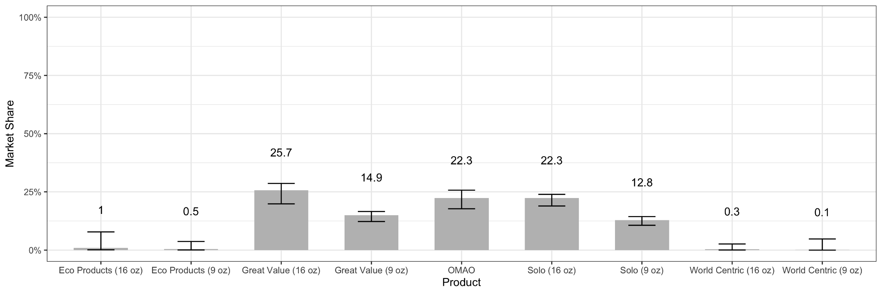
Decreasing Price Significantly Increases Market Share
$0.15/cup, Opaque, Logo, 16 oz, Sustainable, Pack of 50
Notes:
Need to find how to improve market share to remain competitive
Decreased price -> $0.15
Did not want to heavily decrease price based on typical unit costs for competitive sustainable products
Increased market share by 8% (22.3%)
Much closer to top two competitors.

Slide 21
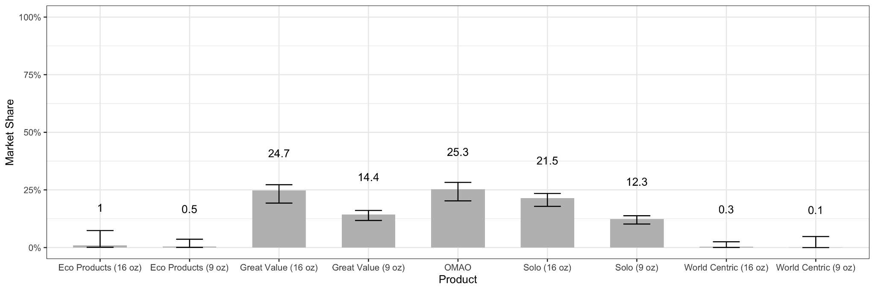
Highest Market Share Comes from Translucent Cup w/o Logo
$0.15/cup, Translucent, No Logo, 16 oz, Sustainable, Pack of 50
Notes:
If you want to find more ways to have the greatest market share, appearance could be changed
Changing cup to translucent and no logo increases the share to 25.3% (3% increase)
Not a significant change, only recommended if largest market share is desired.
Goes against company driven design choice.

Slide 22
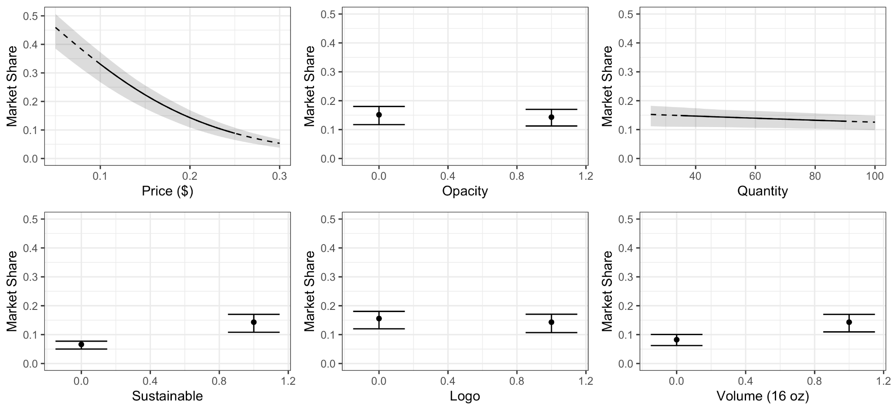
Sensitivity Analysis
With Respect to Baseline Design
($0.20/cup, Opaque, Logo, 16 oz, Sustainable, Pack of 50)
Attributes that the market is most sensitive to are boxed.
Notes:
Market share is most sensitive to price, sustainability, and size
Market is less sensitive to quantity, logo, and opacity

Slide 23
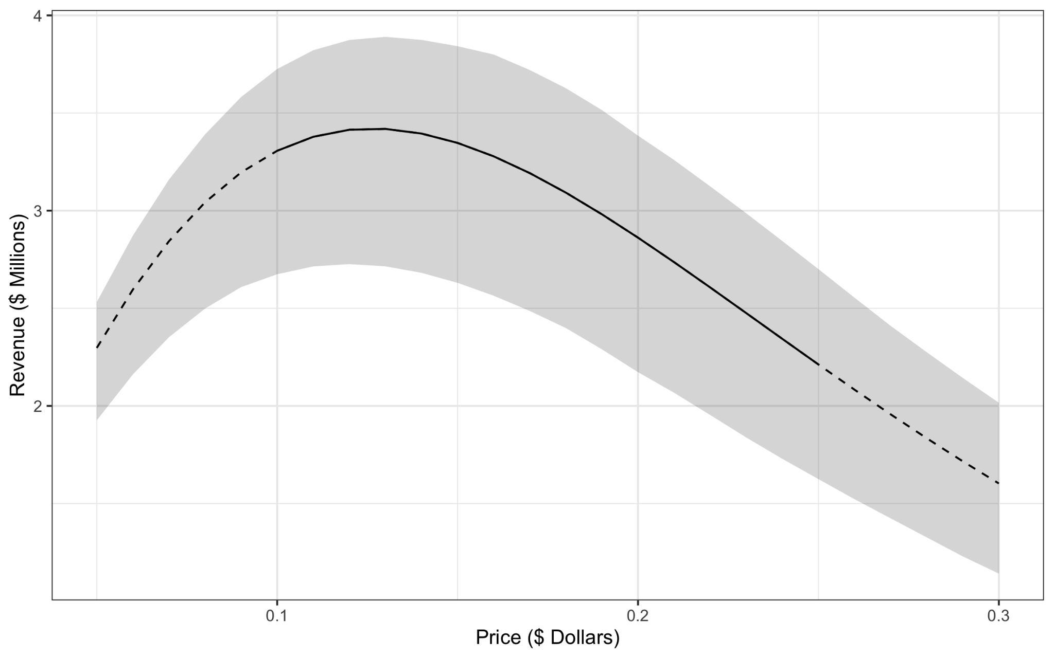
Revenue - Price Sensitivity
W.R.T. a Market Size of 100,000,000 Cups
$3.4M
Price/Cup | Revenue
$0.13 | $3.4M
$0.15 | $3.3M
$0.20 | $2.8M
$0.13

Slide 24
Recommended Design
Material | PHA | (company driven)
Appearance | Opaque w/ Logo | (material constraint) (company driven)
Price/cup | $0.15 | (revenue driven)
Quantity | 50 Cups | (company driven)
Price/package | $7.50 | (revenue driven)
Volume | 16 OZ | (analysis driven)
Notes:
Adding the logo to create a brand

Slide 25
Further Analysis Opportunities
Adding/analyzing more demographic question
Larger sample size (needed ~400)
Production costs considerations

Slide 26
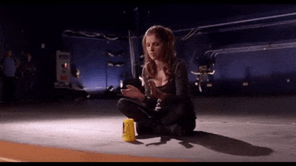
Thank you!
Questions?

